Slide 1
Electronic Devices
Mid Term Lecture - 01
Reference book:
Electronic Devices and Circuit Theory
Robert L. Boylestad and L. Nashelsky , (11th Edition)

Slide 2
Electronic Devices
CHAPTER 1 SEMICONDUCTOR DIODES

Slide 3
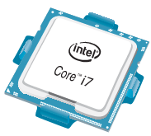
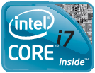
Introduction
Today, the Intel® CoreTM i7 Extreme Edition Processor of Fig. 1.2 has 731 million transistors in a package that is only slightly larger than a 1.67 sq. inches.
In 1965, Dr. Gordon E. Moore presented a paper predicting that the transistor count in a single IC chip would double every two years.
Now, more than 45 years, later we find that his prediction is amazingly accurate and expected to continue for the next few decades.
Figure 1.2: Intel® Core™ i7 Extreme Edition Processor.

Slide 4
Semiconductor Materials: Ge, Si & GaAs
The construction of every discrete (individual) solid-state (hard crystal structure) electronic device or integrated circuit begins with a semiconductor material of the highest quality.
Semiconductors are a special class of elements having a conductivity between that of a good conductor and that of an insulator.
In general, semiconductor materials fall into one of two classes: single-crystal and compound.
Single-crystal semiconductors such as germanium (Ge) and silicon (Si) have a repetitive crystal structure, whereas compound semiconductors such as gallium arsenide (GaAs), cadmium sulfide (CdS), gallium nitride (GaN), and gallium arsenide phosphide (GaAsP) are constructed of two or more semiconductor materials of different atomic structures.
The three semiconductors used most frequently in the construction of electronic devices are Ge, Si, and GaAs.

Slide 5
Semiconductor Materials: Ge, SI & GaAs Contd.
Germanium:
In the first few decades following the discovery of the diode in 1939 and the transistor in 1947 germanium was used almost exclusively because it was relatively easy to find and was available in fairly large quantities.
It was also relatively easy to refine to obtain very high levels of purity, an important aspect in the fabrication process.
However, it was discovered in the early years that diodes and transistors constructed using germanium as the base material suffered from low levels of reliability due primarily to its sensitivity to changes in temperature.

Slide 6
Semiconductor Materials: Ge, SI & GaAs Contd.
Silicon:
At the time, scientists were aware that another material, silicon, had improved temperature sensitivities, but the refining process for manufacturing silicon of very high levels of purity was still in the development stages.
Finally, however, in 1954 the first silicon transistor was introduced, and silicon quickly became the semiconductor material of choice.
Not only is silicon less temperature sensitive, but it is one of the most abundant materials on earth, removing any concerns about availability.

Slide 7
Semiconductor Materials: Ge, SI & GaAs Contd.
Gallium Arsenide:
As time moved on, however, the field of electronics became increasingly sensitive to issues of speed.
The result was the development of the first GaAs transistor in the early 1970s.
This new transistor had speeds of operation up to five times that of Si.
GaAs was more difficult to manufacture at high levels of purity, was more expensive, and had little design support in the early years of development.
However, in time the demand for increased speed resulted in more funding for GaAs research, to the point that today it is often used as the base material for new high-speed, very large scale integrated (VLSI) circuit designs.

Slide 8
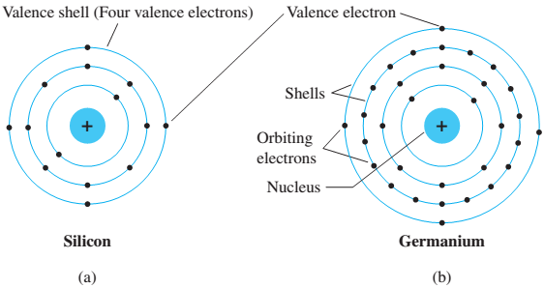
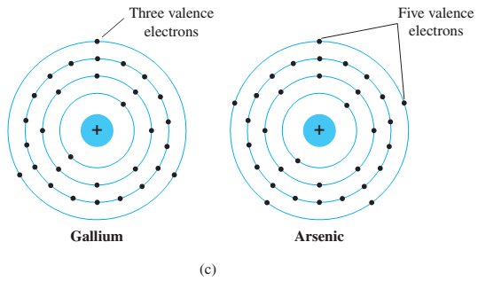

Covalent Bonding and Intrinsic Materials
To fully appreciate why Si, Ge, and GaAs are the semiconductors of choice for the electronics industry requires some understanding of the atomic structure of each and how the atoms are bound together to form a crystalline structure.
The fundamental components of an atom are the electron, proton, and neutron.
In the lattice structure, neutrons and protons form the nucleus and electrons appear in fixed orbits around the nucleus. The Bohr model for the three materials is provided in Fig. 1.3.

Slide 9
Covalent Bonding & Intrinsic Materials Contd.
As indicated in Fig. 1.3, silicon has 14 orbiting electrons, germanium has 32 electrons, gallium has 31 electrons, and arsenic has 33 orbiting electrons (the same arsenic that is a very poisonous chemical agent).
For germanium and silicon there are four electrons in the outermost shell, which are referred to as valence electrons.
Gallium has three valence electrons and arsenic has five valence electrons.
Atoms that have four valence electrons are called tetravalent , those with three are called trivalent, and those with five are called pentavalent.
The term valence is used to indicate that the potential (ionization potential) required to remove any one of these electrons from the atomic structure is significantly lower than that required for any other electron in the structure.

Slide 10
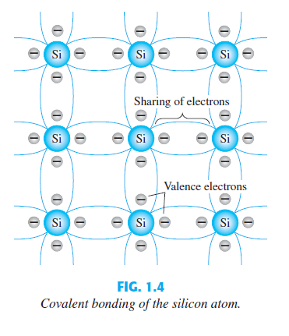
Covalent Bonding & Intrinsic Materials Contd.
In a pure silicon or germanium crystal the four valence electrons of one atom form a bonding arrangement with four adjoining atoms, as shown in Fig. 1.4.
This bonding of atoms, strengthened by the sharing of electrons, is called covalent bonding.

Slide 11
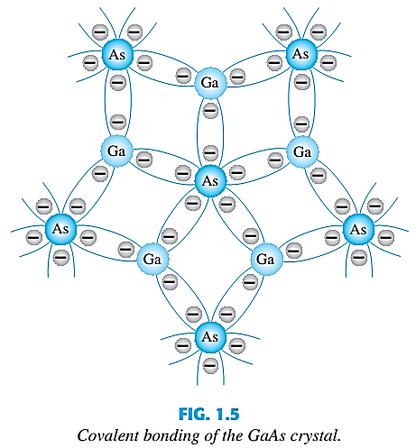
Covalent Bonding & Intrinsic Materials Contd.
Because GaAs is a compound semiconductor, there is sharing between the two different atoms, as shown in Fig. 1.5.
Each atom, gallium or arsenic, is surrounded by atoms of the complementary type. There is still a sharing of electrons similar in structure to that of Ge and Si, but now five electrons are provided by the As atom and three by the Ga atom.

Slide 12
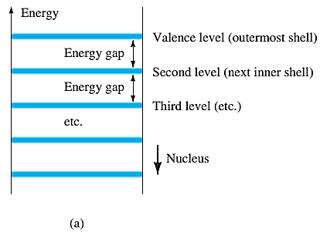
Energy Levels
Within the atomic structure of each and every isolated atom there are specific energy levels associated with each shell and orbiting electron, as shown in Fig. 1.6.
The energy levels associated with each shell will be different for every element.
The farther an electron is from the nucleus, the higher is the energy state, and any electron that has left its parent atom has a higher energy state than any electron in the atomic structure.

Slide 13
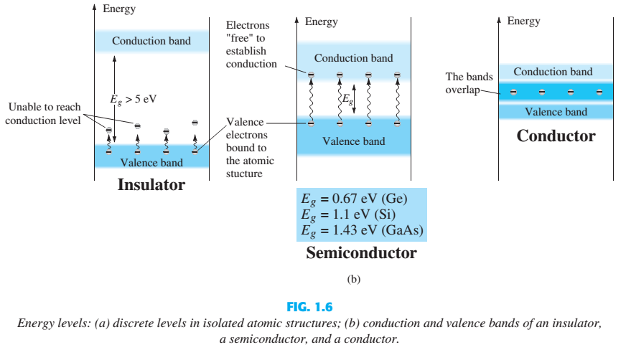
Energy Levels Contd.

Slide 14
n-Type & p-Type Materials
The characteristics of a semiconductor material can be altered significantly by the addition of specific impurity atoms to the relatively pure semiconductor material.
These impurities, although only added at 1 part in 10 million, can alter the band structure sufficiently to totally change the electrical properties of the material.
A semiconductor material that has been subjected to the doping process is called an extrinsic material.
There are two extrinsic materials of immeasurable importance to semiconductor device fabrication: n -type and p -type materials.

Slide 15
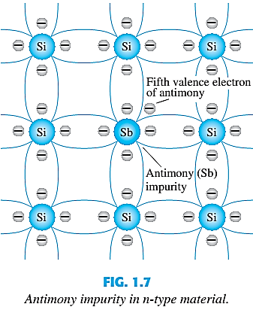
n-Type Material
Both n -type and p -type materials are formed by adding a predetermined number of impurity atoms to a silicon base.
An n -type material is created by introducing impurity elements that have five valence electrons (pentavalent), such as antimony, arsenic, and phosphorus. (Group V elements in Periodic Table)
The effect of such impurity elements is indicated in Fig. 1.7 (using antimony as the impurity in a silicon base).

Slide 16
n-Type Material Contd.
Note that the four covalent bonds are still present. There is, however, an additional fifth electron due to the impurity atom, which is unassociated with any particular covalent bond.
This remaining electron, loosely bound to its parent (antimony) atom, is relatively free to move within the newly formed n -type material.
Diffused impurities with five valence electrons are called donor atoms.
It is important to realize that even though a large number of free carriers have been established in the n -type material, it is still electrically neutral since ideally the number of positively charged protons in the nuclei is still equal to the number of free and orbiting negatively charged electrons in the structure.

Slide 17
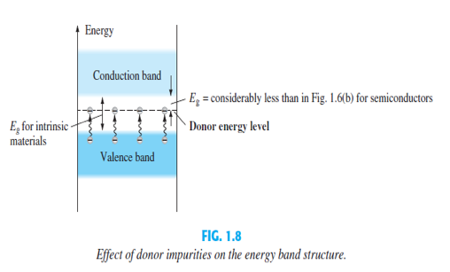
n-Type Material Contd.
Those free electrons due to the added impurity sit at this energy level and have less difficulty absorbing a sufficient measure of thermal energy to move into the conduction band at room temperature.
The result is that at room temperature, there are a large number of carriers (electrons) in the conduction level, and the conductivity of the material increases significantly.

Slide 18
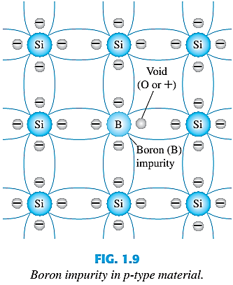
p-Type Material
The p -type material is formed by doping a pure germanium or silicon crystal with impurity atoms having three valence electrons.
The elements most frequently used for this purpose are boron, gallium, and indium. (Group III elements in Periodic Table)
Note that there is now an insufficient number of electrons to complete the covalent bonds of the newly formed lattice.

Slide 19
p-Type Material Contd.
The resulting vacancy is called a hole and is represented by a small circle or a plus sign, indicating the absence of a negative charge.
Since the resulting vacancy will readily accept a free electron:
The diffused impurities with three valence electrons are called acceptor atoms.
The resulting p -type material is electrically neutral, for the same reasons described for the n -type material.

Slide 20
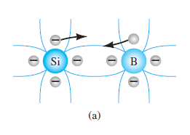
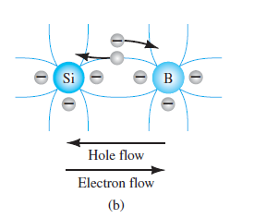
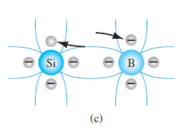
Electron vs Hole Flow
The effect of the hole on conduction is shown in Fig. If a valence electron acquires sufficient kinetic energy to break its covalent bond and fills the void created by a hole, then a vacancy, or hole, will be created in the covalent bond that released the electron.

Slide 21
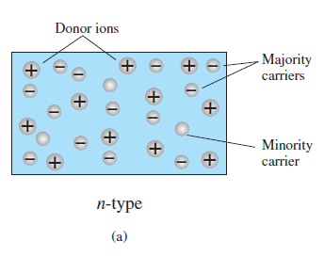
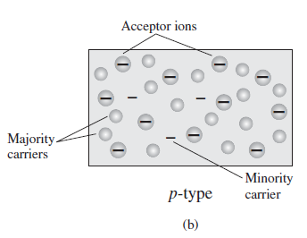
Majority & Minority Carriers
In an n-type material ( Fig. a ) the electron is called the majority carrier and the hole the minority carrier.
In a p-type material the hole is the majority carrier and the electron is the minority carrier.

Slide 22
Thank You

